Slide 1
PIPELINING
.

Slide 2
Traditional Pipeline Concept
Laundry Example
Ann, Brian, Cathy, Dave
each have one load of clothes
to wash, dry, and fold
Washer takes 30 minutes
Dryer takes 40 minutes
“Folder” takes 20 minutes
A
B
C
D

Slide 3
Traditional Pipeline Concept
6 PM
7
8
9
10
11
Midnight
Time
30
40
20
30
40
20
30
40
20
30
40
20
Sequential laundry takes 6 hours for 4 loads
If they learned pipelining, how long would laundry take?
A
B
C
D

Slide 4
Traditional Pipeline Concept
6 PM
7
8
9
10
11
Midnight
T
a
s
k
O
r
d
e
r
Time
30
40
40
40
40
20
A
Pipelined laundry takes 3.5 hours for 4 loads
B
C
D

Slide 5
Traditional Pipeline Concept
6 PM
Pipelining doesn’t help latency of single task, it helps throughput of entire workload
Pipeline rate limited by slowest pipeline stage
Multiple tasks operating simultaneously using different resources
Potential speedup = Number pipe stages
Unbalanced lengths of pipe stages reduces speedup
Time to “fill” pipeline and time to “drain” it reduces speedup
Stall for Dependences
7
8
9
Time
T
a
s
k
O
r
d
e
r
30
40
40
40
40
20
A
B
C
D

Slide 6
Basic Concepts
Pipelining is an implementation technique in which multiple instructions are overlapped in execution

Slide 7
Overview
Pipelining is widely used in modern processors.
Pipelining improves system performance in terms of throughput.
Pipelined organization requires sophisticated compilation techniques.

Slide 8
Making the Execution of Programs Faster
Use faster circuit technology to build the processor and the main memory.
Arrange the hardware so that more than one operation can be performed at the same time.
In the latter way, the number of operations performed per second is increased even though the elapsed time needed to perform any one operation is not changed.

Slide 9
Use the Idea of Pipelining in a Computer
Fetch + Execution
T
ime
I
I
I
1
2
3
T
ime
Clock cycle
1
2
3
4
F
1
E
1
F
2
E
2
F
3
E
3
Instruction
I
F
E
(a) Sequential execution
1
1
1
I
F
E
2
2
2
Interstage buffer
B1
I
F
E
3
3
3
Instruction
Ex
ecution
fetch
unit
(c) Pipelined execution
unit
(b) Hardware organization
Figure 8.1. Basic idea of instruction pipelining.

Slide 10

Use the Idea of Pipelining in a Computer
T
ime
Clock cycle
1
2
3
4
5
6
7
Instruction
I
F
1
1
E
1
W
1
1
D
I
F
2
D
2
E
2
W
2
2
I
F
3
D
3
E
3
W
3
3
I
F
4
D
4
E
4
W
4
4
(a) Instruction execution divided into four steps
fers
Interstage b
uf
F : Fetch
D : Decode
instruction
instruction
E: Ex
ecute
W : Write
and fetch
operation
results
operands
B1
B2
B3
(b) Hardware organization
Fetch + Decode
+ Execution + Write
A 4-stage pipeline.

Slide 11
Pipeline Performance
The potential increase in performance resulting from pipelining is proportional to the number of pipeline stages.
However, this increase would be achieved only if all pipeline stages require the same time to complete, and there is no interruption throughout program execution.
Unfortunately, this is not true.

Slide 12
Pipelining improves performance by increasing instruction throughput, as opposed to decreasing the execution time of individual instruction.
Instruction throughput is the important metric because the real programs execute billions of instructions.

Slide 13
Pipeline Performance
pipelining does not result in individual instructions being executed faster; rather, it is the throughput that increases.
Throughput is measured by the rate at which instruction execution is completed.
Pipeline stall causes degradation in pipeline performance.
We need to identify all hazards that may cause the pipeline to stall and to find ways to minimize their impact.

Slide 14
Pipeline Performance
Pipeline hazards are situations that prevent the next instruction in the instruction stream from executing during its designated clock cycles.
Any condition that causes a stall in the pipeline operations can be called a hazard.
There are primarily three types of hazards:
i . Structural Hazards
ii. Data Hazards
iii. Control Hazards or Branch Hazards (Instruction hazards)

Slide 15
Pipeline Hazards
A pipeline hazard occurs when the pipeline, or some portion of the pipeline, must stall because conditions do not permit continued execution.
Such a pipeline stall is also referred to as a pipeline bubble.
There are three types of hazards:
Resource
Data
Control

Slide 16
RESOURCE HAZARDS
Structural hazard
A resource hazard occurs when two (or more) instructions that are already in the pipeline need the same resource.
The result is that the instructions must be executed in serial rather than parallel for a portion of the pipeline

Slide 17
Resource conflicts occur when two or more instructions in the pipeline require the same hardware resource at the same time, leading to a stall or delay in execution.
Example:
﻿﻿Suppose an instruction is fetching data from memory, while another instruction at a different pipeline stage is writing data to memory.
﻿﻿If the memory unit can handle only one access at a time, the second instruction must wait, causing a stall.

Slide 18
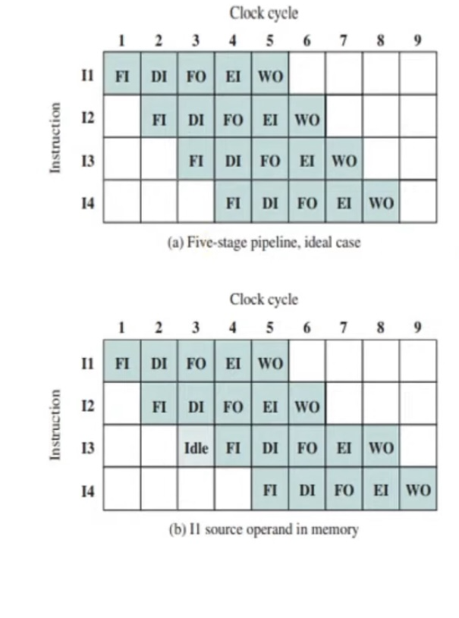
RESOURCE HAZARDS
In the ideal case, a new instruction enters the pipeline each clock cycle
"assume that main memory has a single port and that all instruction fetches and data reads and writes must be performed one at a time
Instruction
﻿In this case, an operand read to or write from memory cannot be performed in parallel with an instruction fetch
﻿﻿Therefore, the fetch instruction stage of the pipeline must idle for one cycle before beginning the instruction fetch for instruction I3.
﻿Another example of a resource conflict is a situation in which
Instruction
multiple instructions are ready to enter the execute instruction phase and there is a single ALU.
-One solutions to such resource hazards is to increase available resources, such as having multiple ports into main memory and multiple ALU units.

Slide 19
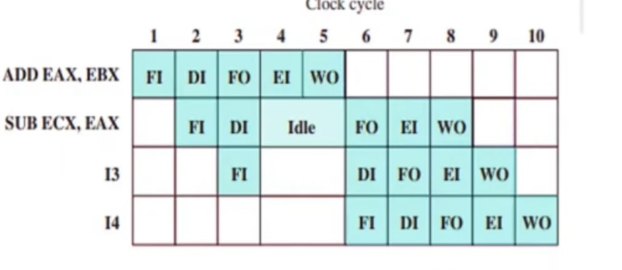
DATA HAZARDS
﻿A data hazard occurs when there is a conflict in the access of an operand location.
﻿In general terms, we can state the hazard in this form: Two instructions in a program are to be executed in sequence and both access a particular memory or register operand.
If the two instructions are executed in strict sequence, no problem occurs.
If the instructions are executed in a pipeline, then it is possible for the operand value to be updated producing different result

Slide 20
DATA HAZARDS
Data dependency conflicts occur when an instruction depends on the result of a previous instruction, but that result has not yet been computed.
Consider the following sequence of instructions in a program:
ADD R1, R2, R3 // R1 = R2 + R3 2.
SUB R4, R1, R5 // R4 = R1 - R5 3.
AND R6, R1, R7 // R6 = R1 & R7
Instruction 2 (SUB R4, R1, R5) depends on the result of Instruction 1 (ADD R1, R2, R3) because it uses the value of R1 that is computed by the ADD instruction.
Similarly, Instruction 3 (AND R6, R1, R7) also depends on the result of Instruction 1 because it uses the value of R1.

Slide 21
DATA HAZARDS
﻿There are three types of data hazards;
﻿﻿Read after write (RAW), or true dependency: An instruction modifies a register or memory location and a succeeding instruction reads the data in that memory or register location. A hazard occurs if the read takes place before the write operation is complete.
﻿﻿Write after read (WAR), or antidependency: An instruction reads a register or memory location and a succeeding instruction writes to the location.
﻿A hazard occurs if the write operation completes before the read operation takes place.
﻿﻿Write after write (WAW), or output dependency: Two instructions both write to the same location. A hazard occurs if the write operations take place in the reverse order of the intended sequence.

Slide 22
CONTROL HAZARDS
Control hazards occur due to branching instructions (like conditional branches or jumps), where the processor doesn't know which instruction to fetch next until the branch decision is made.
Detection:
﻿﻿Detect when a branch instruction is encountered in the pipeline, which causes a change in the flow of control.
﻿﻿Example: If the processor executes a branch instruction (BEQ, JMP), it doesn't know if the next instruction will be fetched from the current sequence or a different memory address (based on the branch outcome).

Slide 23
Branch differences (Control Hazards) occur when a pipeline must make decisions based on the outcome of a conditional instruction, like a branch or jump.
Since branch instructions change the flow of execution, the processor does not know in advance which instruction should be fetched next.
• Example:
BEQ R1, R2, LABEL; If R1 == R2, jump to LABEL ADD R3, R4, R5 ; Should this be executed or not?
﻿﻿The processor does not know whether to take the branch until it evaluates R1 == R2.
﻿﻿If the branch is taken, already-fetched instructions are invalid, leading to wasted cycles.

Slide 24
CONTROL HAZARDS
• A branch hazard, occurs when the pipeline makes the wrong decision on a branch prediction and therefore brings instructions into the pipeline that must subsequently be discarded.
A variety of approaches have been taken for dealing with conditional branches:
﻿﻿Multiple streams
﻿﻿Prefetch branch target
﻿﻿Loop buffer
﻿﻿Branch prediction
﻿﻿Delayed branch

Slide 25
CONTROL HAZARDS HANDLING
MULTIPLE STREAMS
A simple pipeline suffers a penalty for a branch instruction because it must choose one of two instructions to fetch next and may make the wrong choice.
﻿﻿It is possible to maintain two pipelines of initial instructions. One pipeline would contain the instructions following the branch and the other pipeline would contain in instructions from the target address.
﻿There are two problems with this approach:
﻿With multiple pipelines there are contention delays for access to the registers and to memory.
﻿﻿Additional branch instructions may enter the pipeline (either stream) before the original branch decision is resolved. Each such instruction needs an additional stream.
IBM 370/168 and the IBM 3033 processor's use this approach.

Slide 26
CONTROL HAZARDS HANDLING
PREFETCH BRANCH TARGET
﻿﻿When a conditional branch is recognized, the target of the branch is prefetched, in addition to the instruction following the branch.
﻿This target is then saved until the branch instruction is executed. If the branch is taken, the target has already been prefetched.
﻿The IBM 360/91 uses this approach.

Slide 27
CONTROL HAZARDS HANDLING
LOOP BUFFER
A loop buffer is a small, very-high-speed memory maintained by the instruction fetch stage of the pipeline and containing the n most recently fetched instructions, in sequence.
• If a branch is to be taken, the hardware first checks whether the branch target is within the buffer.
If so, the next instruction is fetched from the buffer.
• CRAY-1 machine uses this approach

Slide 28
CONTROL HAZARDS HANDLING
LOOP BUFFER
•The loop buffer has three benefits:
﻿﻿﻿With the use of prefetching, the loop buffer will contain some instructions sequentially ahead of the current instruction fetch address. Thus, instructions fetched in sequence will be available without the usual memory access time.
﻿﻿﻿If a branch occurs to a target just a few locations ahead of the address of the branch instruction, the target will already be in the buffer. This is useful for IF-THEN and IF-THEN-ELSE sequences.
﻿﻿It is suited to dealing with loops, or iterations; hence the name loop buffer.
If the loop buffer is large enough to contain all the instructions in a loop, then those instructions need to be fetched from memory only once, for the first iteration. For subsequent iterations, all the needed instructions are already in the buffer.

Slide 29

CONTROL HAZARDS HANDLING
DELAYED BRANCH
It is possible to improve pipeline performance by automatically rearranging instructions within a program, so that branch instructions occur later than actually desired
BRANCH PREDICTION
Various techniques can be used to predict whether a branch will be taken. Among the more common are the following:
• Predict never taken Static:do not depend on the execution history
• Predict always taken
﻿﻿Predict by opcode
Taken/not taken switch. Dynamic
﻿﻿Branch history table

Slide 30
CONTROL HAZARDS HANDLING
BRANCH PREDICTION
Predict never taken: most popular of all the branch prediction methods. always assume that the branch will not be taken and continue to fetch instructions in sequence.
﻿﻿﻿Predict always taken : Studies analyzing program behavior have shown that conditional branches are taken more than 50% of the time ,so always prefetching from the branch target address should give better performance than always prefetching from the sequential path.
﻿﻿﻿Predict by opcode :The processor assumes that the branch will be taken for certain branch opcodes and not for others. Success rates of greater than 75% is reported for this strategy.

Slide 31
CONTROL HAZARDS HANDLING
BRANCH PREDICTION
Dynamic branch strategies attempt to improve the accuracy of prediction by recording the history of conditional branch instructions in a program.
﻿4.one or more bits can be associated with each conditional branch instruction that reflect the recent history of the instruction. These bits are referred to as a taken/not taken switch that directs the processor to make a particular decision the next time the instruction is encountered
5.The branch history table is a small cache memory associated with the instruction fetch stage of the pipeline.
Each entry in the table consists of three elements: the address of a branch instruction, some number of history bits that record the state of use of that instruction, and information about the target instruction.

